Slide 1
Gigabit Ethernet Switch
Project description
FPGA Design for Communications Systems

Slide 2
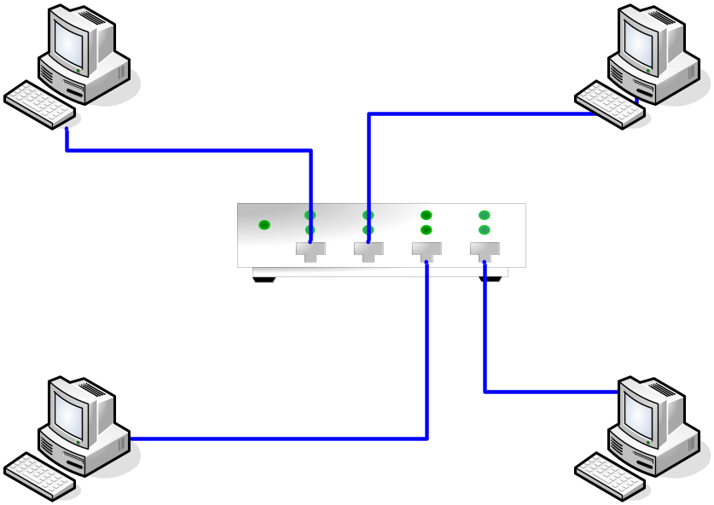
Motivation
Ethernet is the protocol of choice for private and corporate Local Area Networks.
Old shared bus (coaxial cables) and hub based solutions broadcast the traffic to all clients.
  inefficient bandwidth utilization, high collision probability and limited security.
  A switch will only send the traffic where it needs to go, and delete all invalid frames.
Ethernet Local Area Networks are often used for file sharing, automatic hard drive image restoration etc
  large bandwidth requirements -> this is why we need Gigabit Ethernet.

Slide 3

Overview of GE switch task
Objectives of the task
Basic switch functionality
  Ethernet protocol and frame format
  FCS-check (CRC-32)
  MAC-learning
  Fair queuing/scheduling
  Architecture and buffering system
  Transceiver interface
Design task
Implementation issues

Slide 4
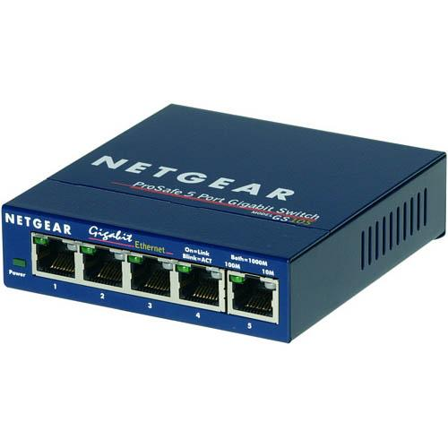
Objectives of the task
Design a 4-portet Gigabit Ethernet switch

Slide 5
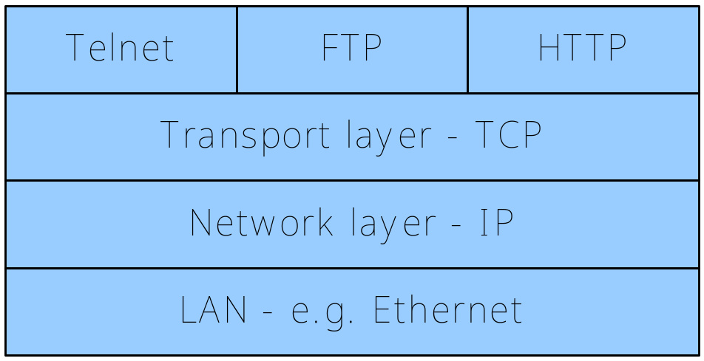
Ethernet protocol and frame format
Layer 2 of the ISO model – Data Link Layer.

Slide 6
Ethernet protocol and frame format
802.3 MAC Frame
Preamble | Start-of-Frame-Delimiter | Destination MAC | Source MAC | Ethertype/ Length | Payload | FCS | Interframe gap
7 octets of 10101010 | 1 octet of 10101011 | 6 octets | 6 octets | 2 octets | 46–1500 octets | 4 octets | 12 octets
 |  | 64–1518 octets
72–1526 octets
Preample and Interframe gap: Separates the MAC frames over the serial interface.
SMAC and DMAC: Physical MAC addresses of the source and destination.
Ethertype: Specifies the payload type (ex. IP packet).
Payload: Upper protocol data (IP packet, ARP request etc.)
FCS: CRC-32 Frame Check Sum used for detecting corrupted frames.

Slide 7
FCS Checksum
802.3 MAC Frame
Preamble | Start-of-Frame-Delimiter | Destination MAC | Source MAC | Ethertype/ Length | Payload | FCS | Interframe gap
7 octets of 10101010 | 1 octet of 10101011 | 6 octets | 6 octets | 2 octets | 46–1500 octets | 4 octets | 12 octets
 |  | 64–1518 octets
72–1526 octets
32-bit frame check sum
Used to detect frames which have been corrupted during transmission
Corrupted frames should not be forwarded
You will implement the FCS calculation circuit in an upcoming exercise ☺

Slide 8
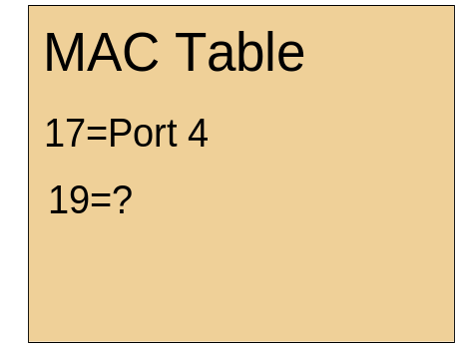
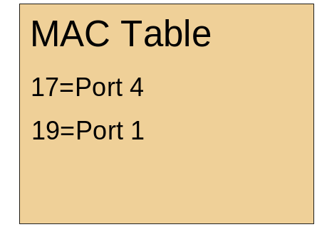
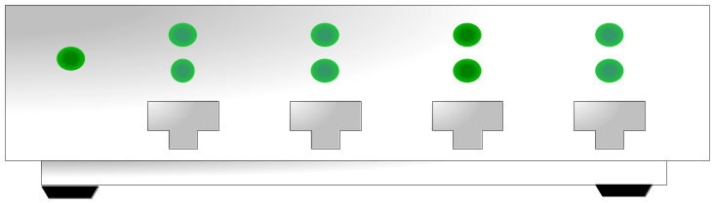
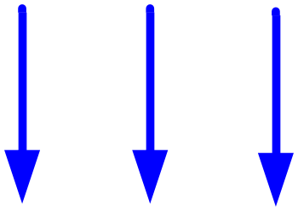
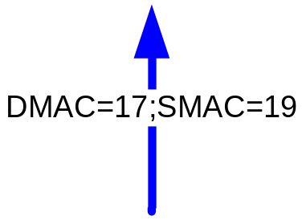
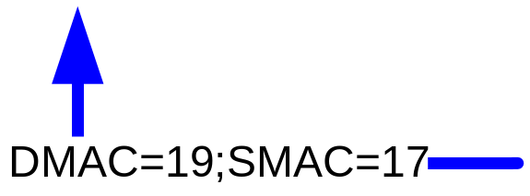
MAC-learning
MAC learning and MAC table lookup is not as simple as it may seem.

Slide 9
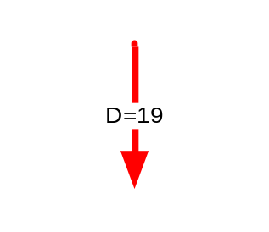
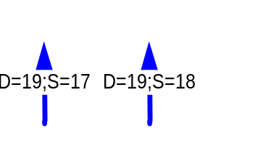
Fair queuing/scheduling
Congestion caused by
  inadequate switch capacity
  multiple flows towards one host.
Possible solution:
  Frame buffering
  Fair transmission scheduling

Slide 10


Switching - Considerations
General switching architecture
Buffering scheme

Slide 11
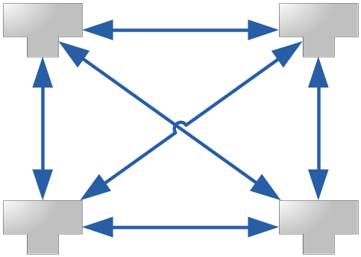
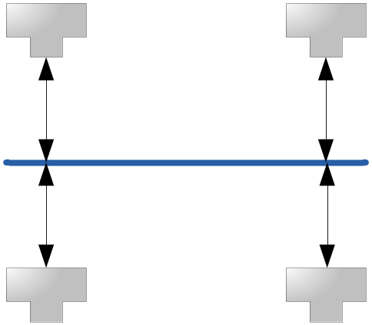



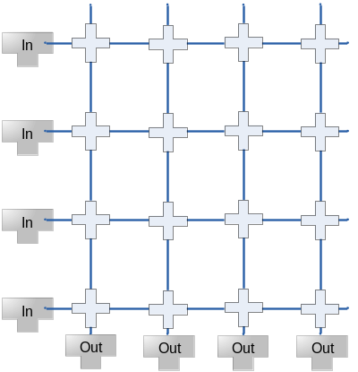
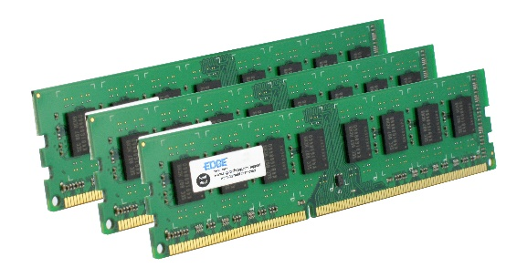
Architecture
Full Mesh
Bus
Shared Memory
Cross-bar

Slide 12
Buffering
Input buffered
Output buffered
Virtual Output Queueing

Slide 13
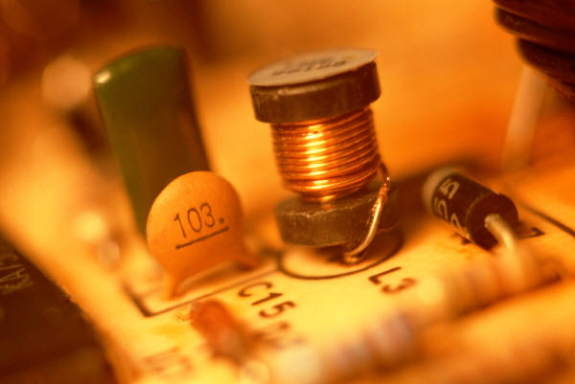
Transceiver Interface
The physical interface is beyond the scope of this project
You need to supply a parallel interface which can later be connected to the physical layer.
Gigabit Media Independent Interface (GMII) is appropriate.

Slide 14
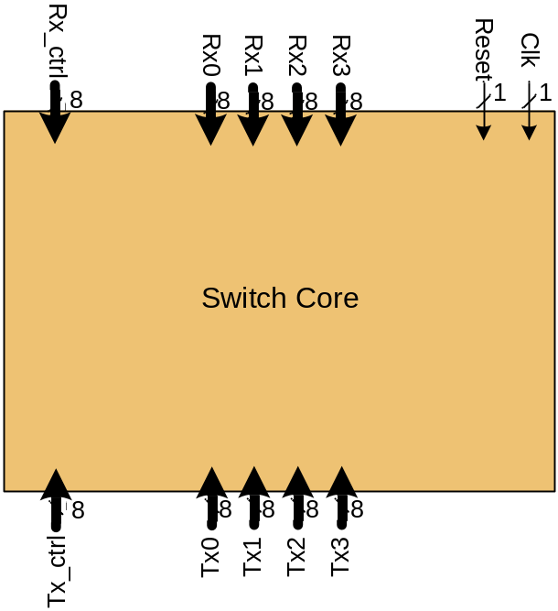
Gigabit Switch Design Task
Design a Gigabit Switch Core block in VHDL
Networks interface runs at 1000Mb/s (8bit parallel)

Slide 15
Design task (II)
Requirements:
  The design must be able to handle a total of 8k MAC addresses
  The design must support frame sizes ranging from 64B to 1518B (excl. IFG and preamble).
  GMII Interface
  The switch must be non-blocking
  No frame reordering of frames from the same flow
Your job:
  Decide a switch structure and consider the tradeoffs between different switch structures (buffering system/scheduler)
  Design a testbench, which tests the implemented functionality

Slide 16
Design Issues
Understand the function
  Write a specification
  Textual representation and block diagrams
  Interfaces and functions within sub blocks
Partition in smaller functional units
  What can be done on chip
  Data structures placed in external memory (and their size and BW)
Testing
  How can it be tested (and how much does the test cover???)
Team size: Appropriate for 3-4 persons

